Slide 1
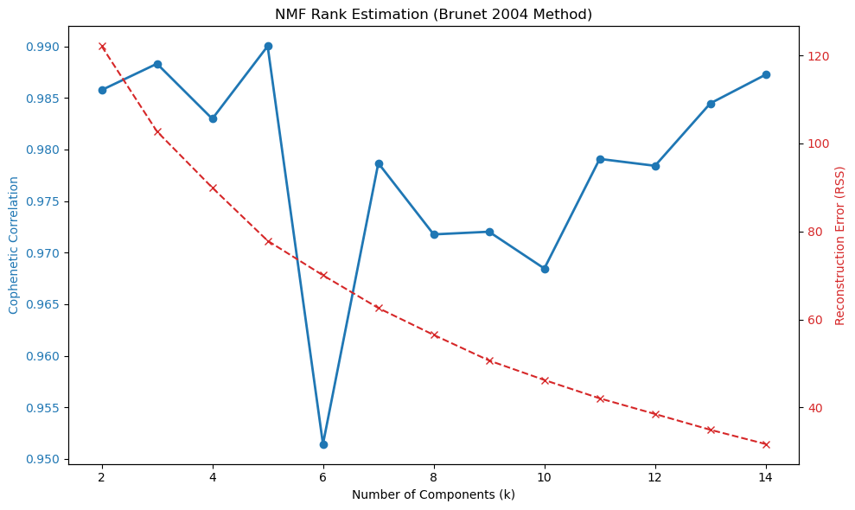

Slide 2
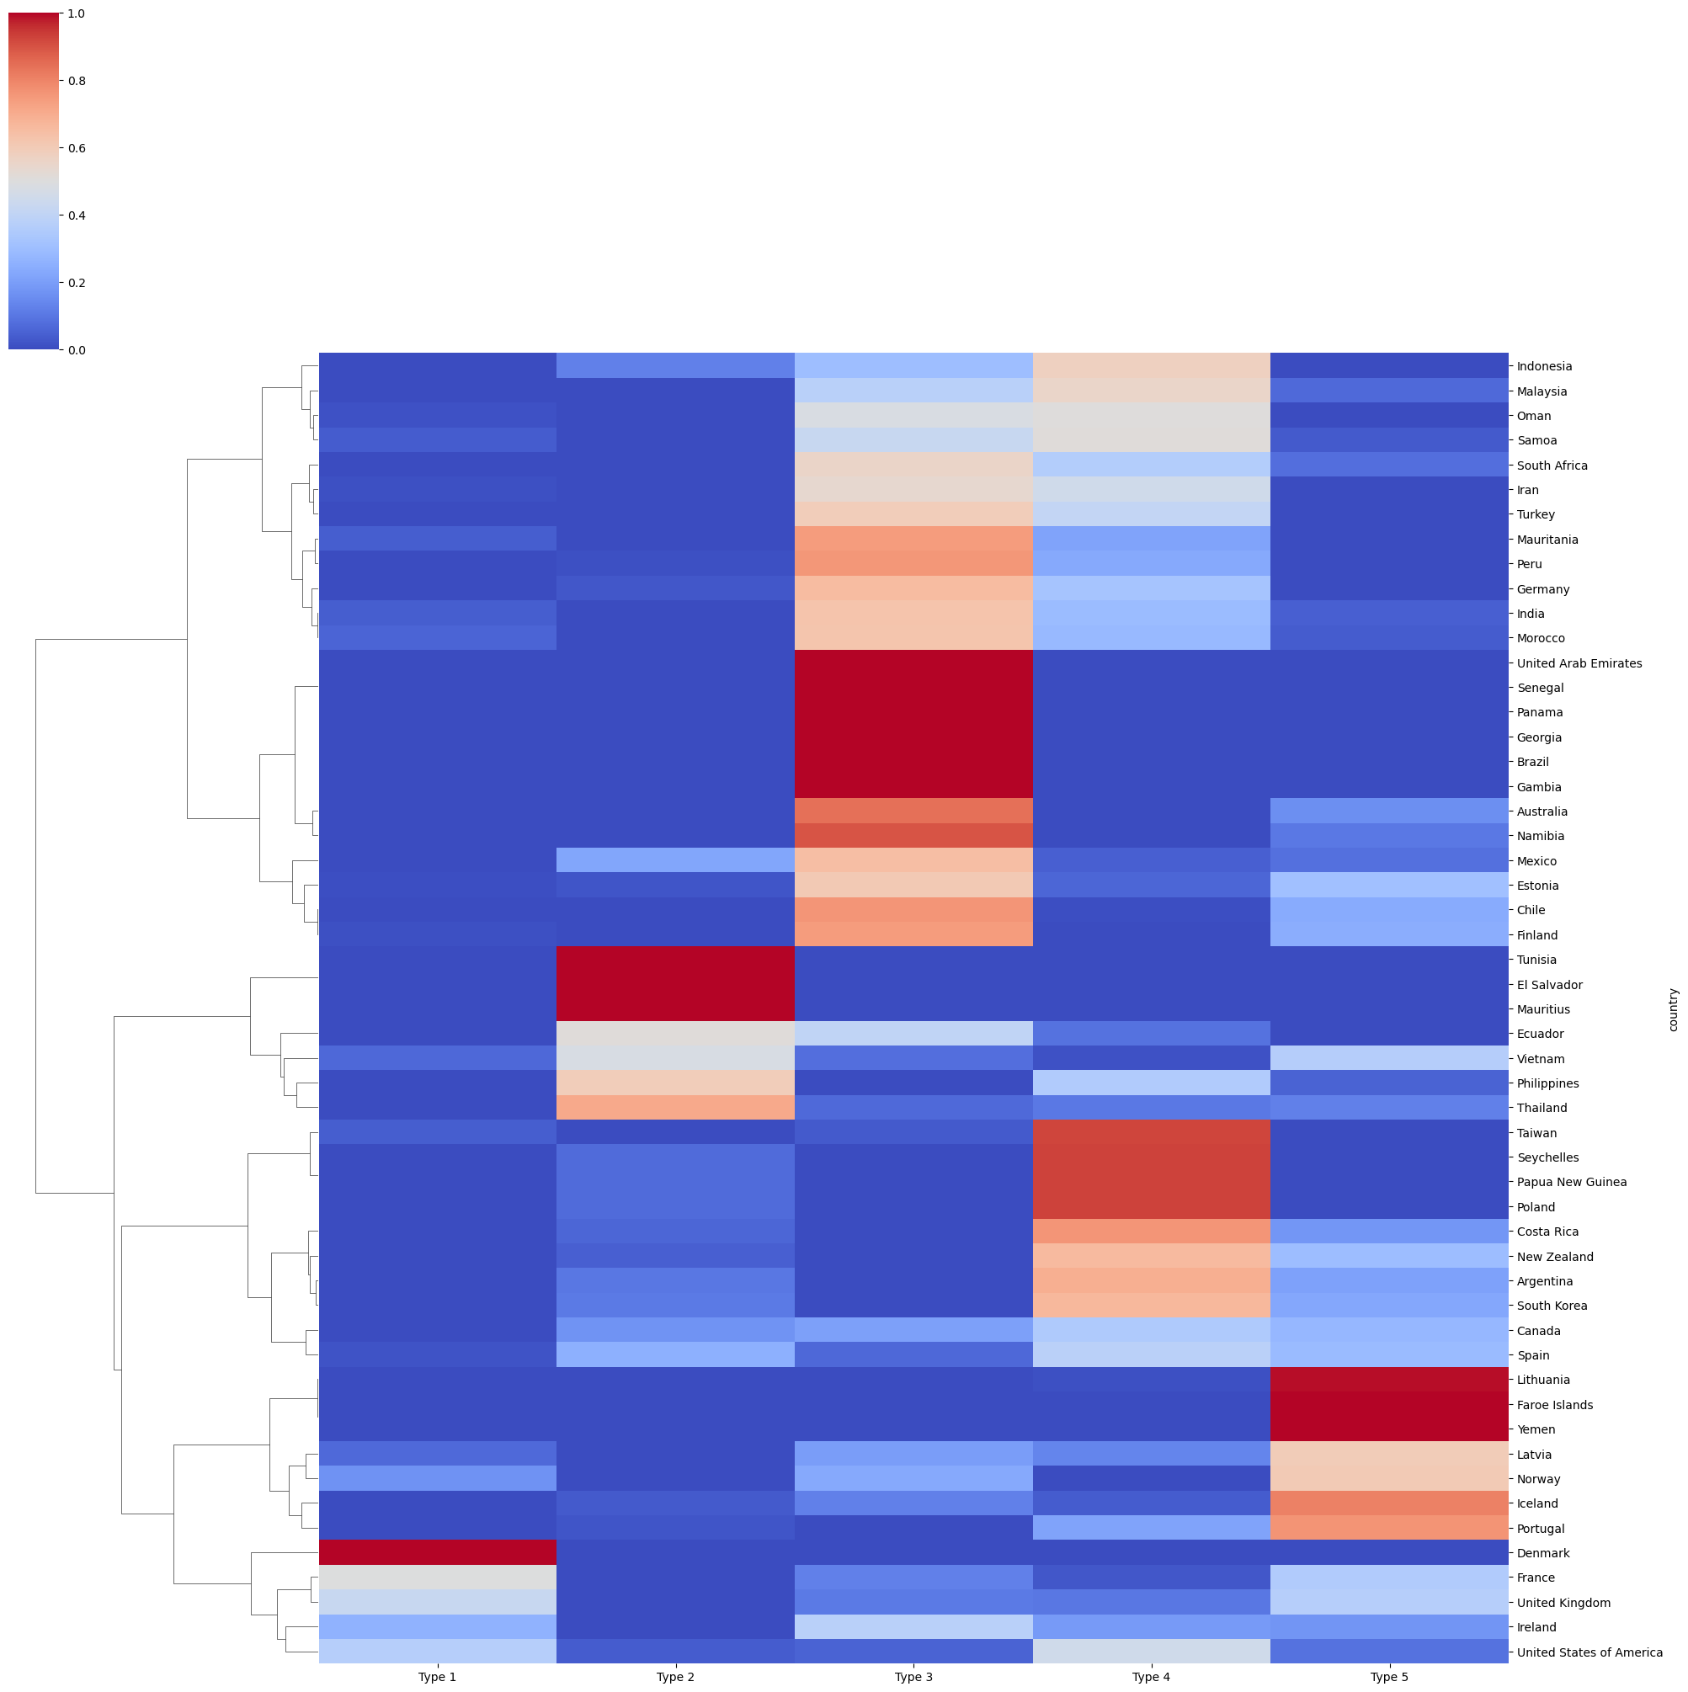
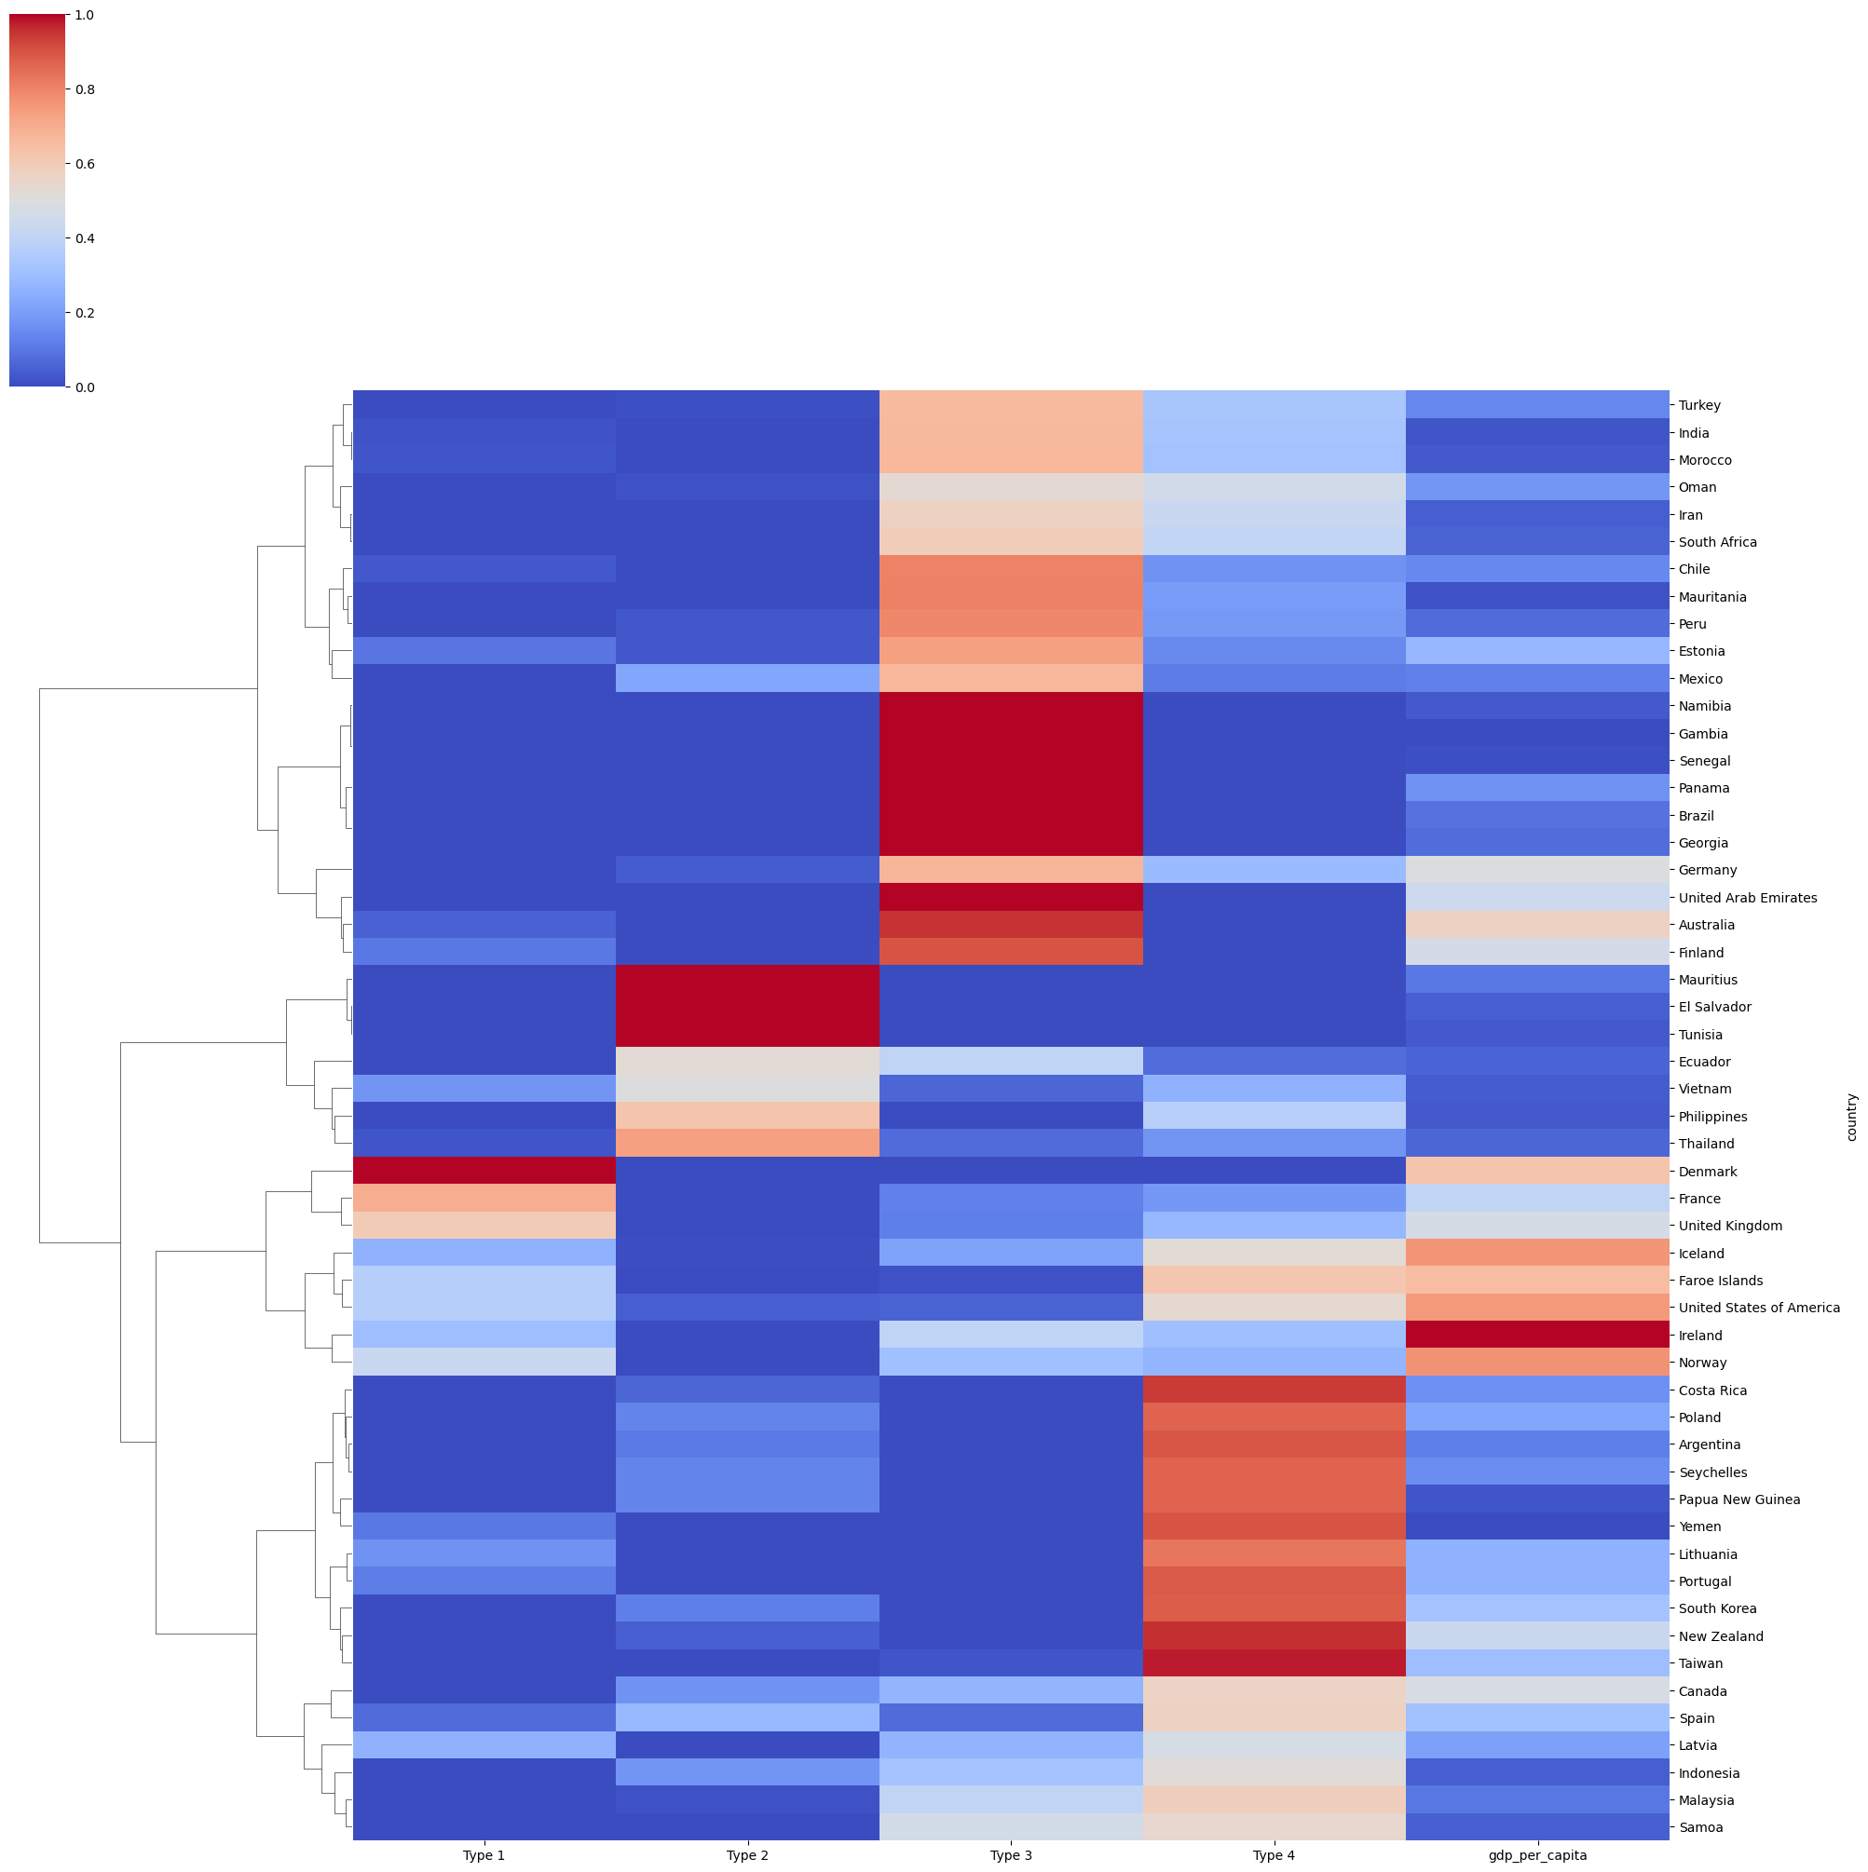
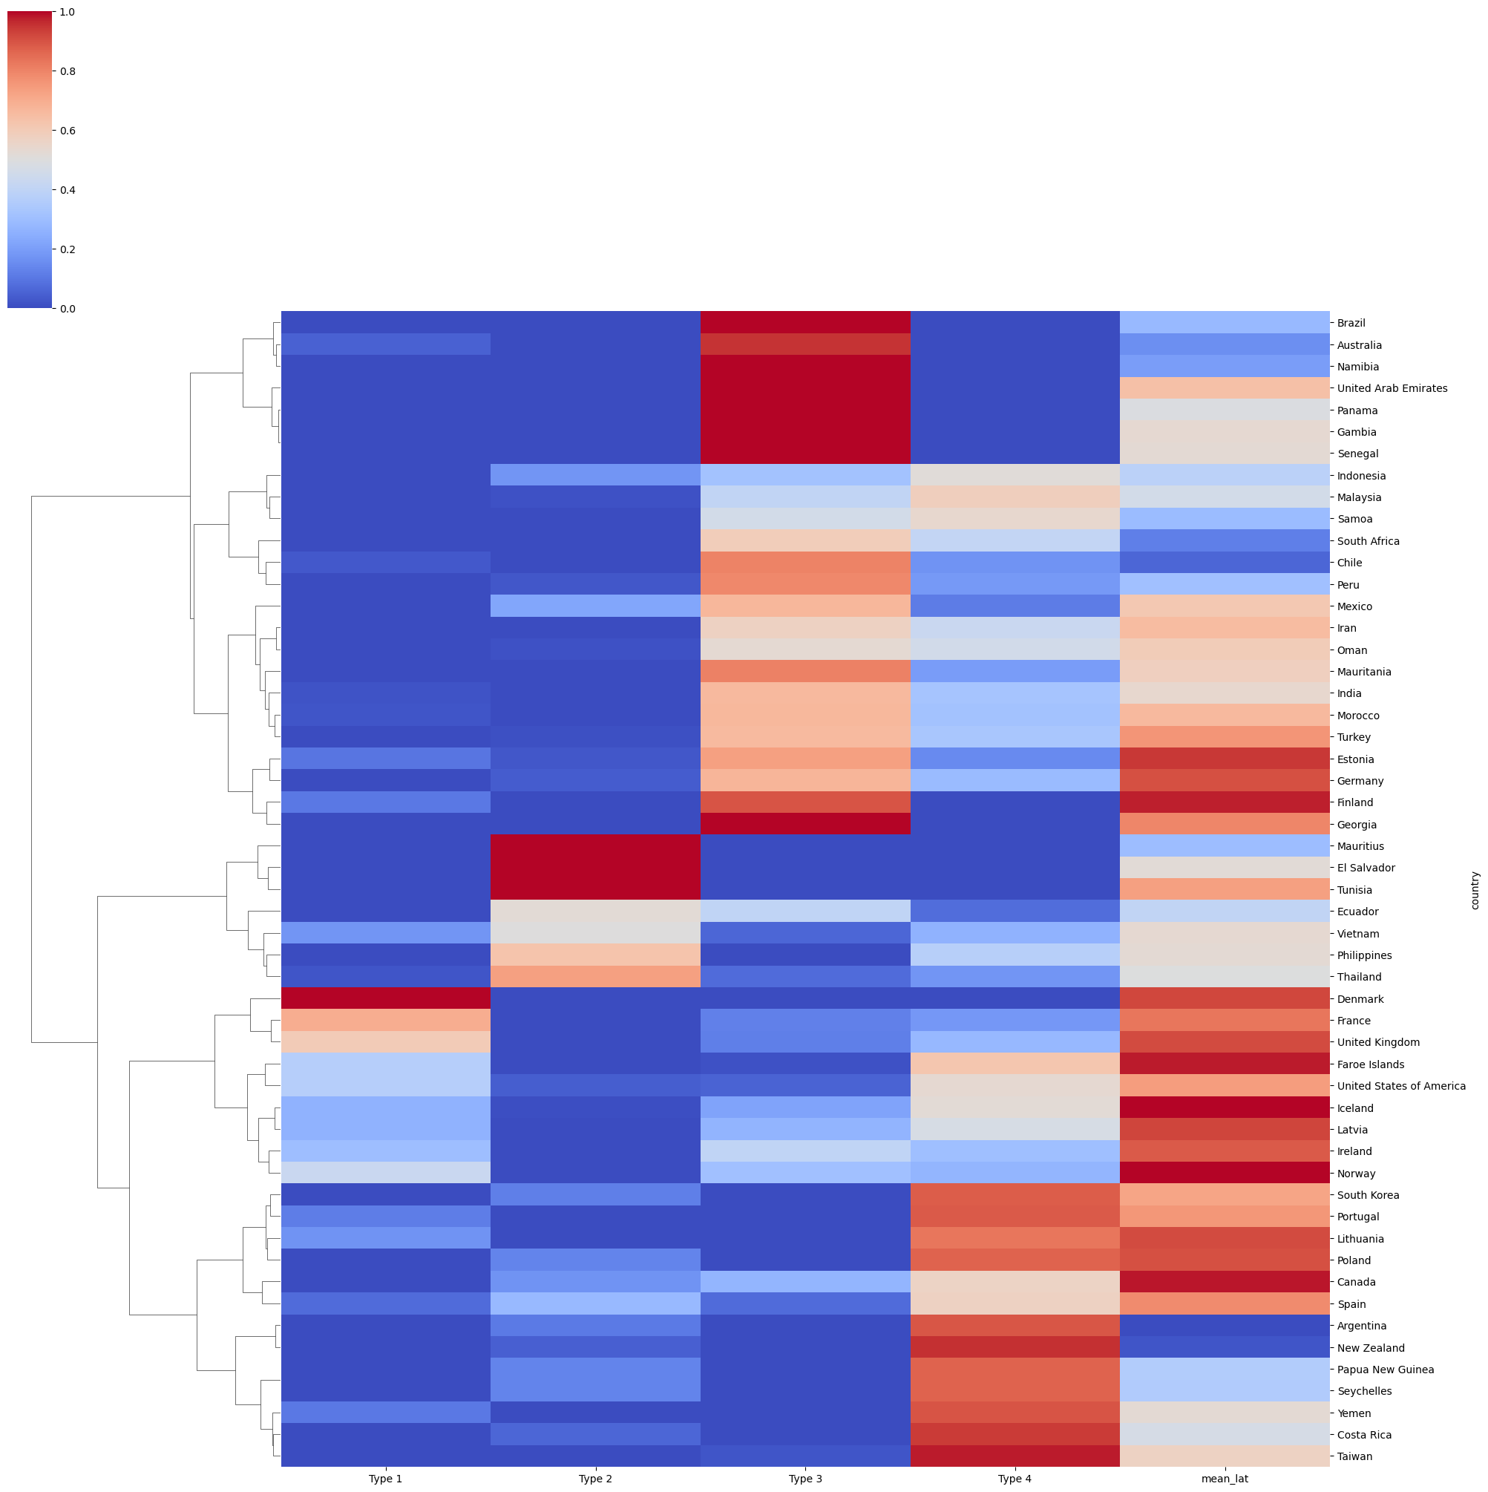
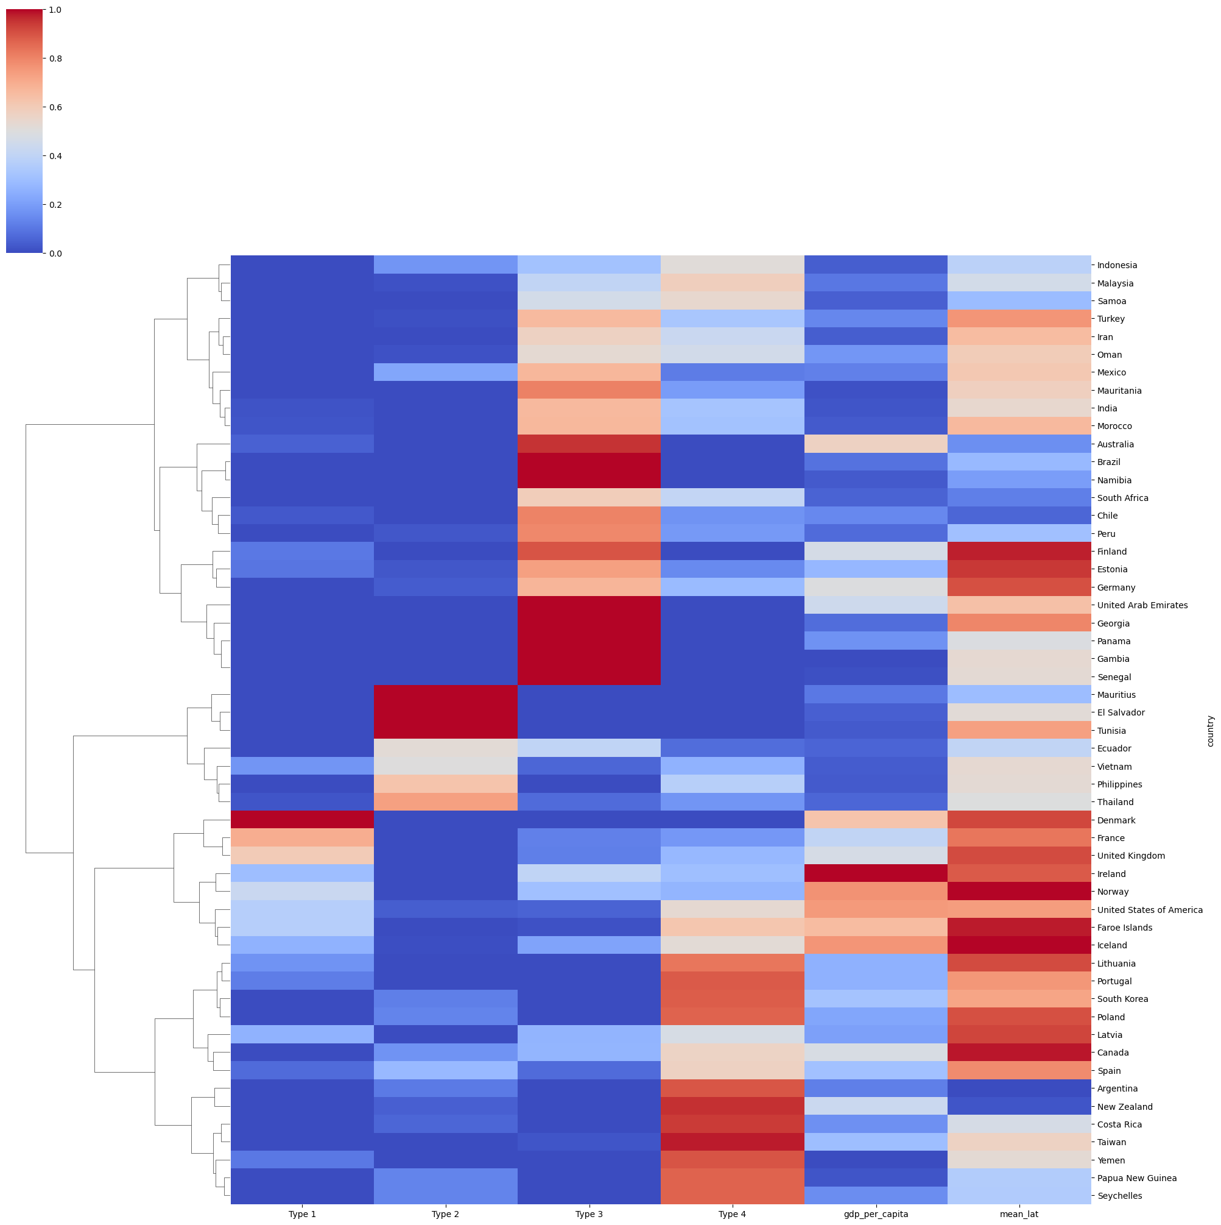
K=4
Profile
Profile + gdp
Profile + mean lat
Profile + gdp + mean lat

Slide 3
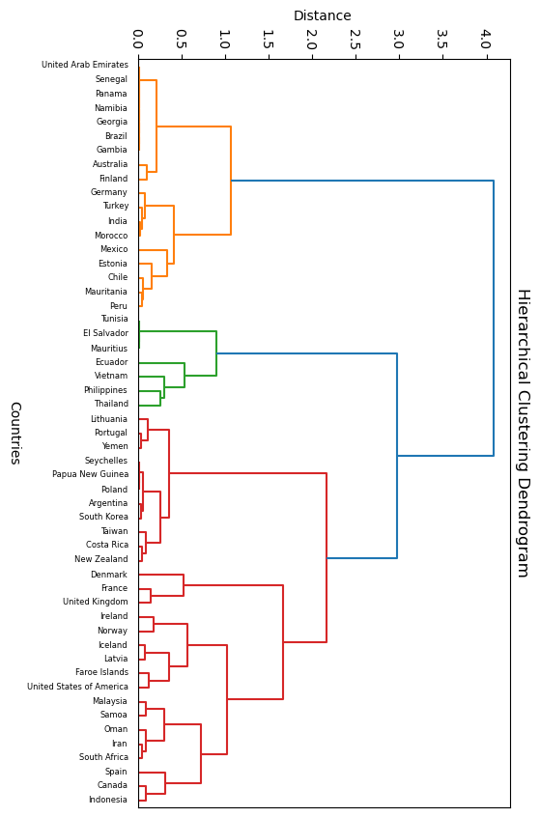
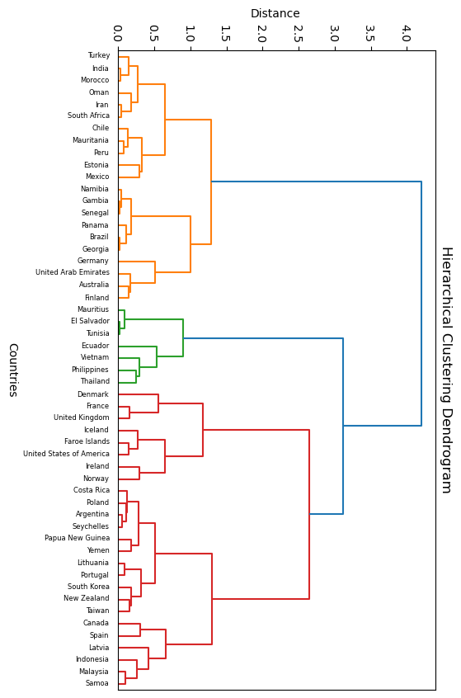
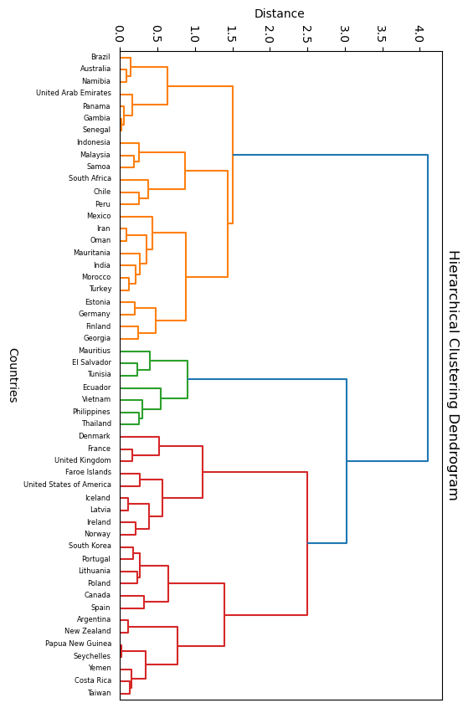
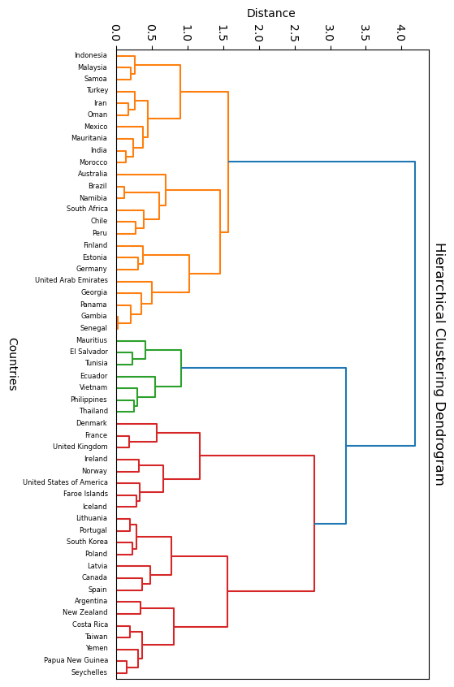
Profile
Profile + gdp
Profile + mean lat
Profile + gdp + mean lat

Slide 4
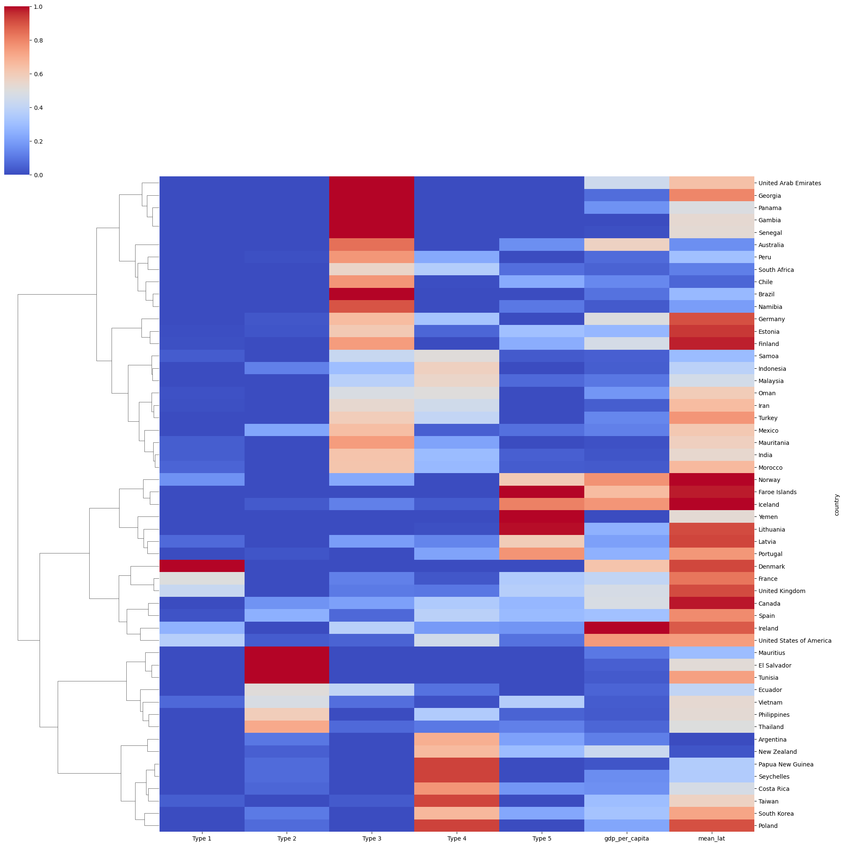
K=5
Profile
Profile + gdp
Profile + mean lat
Profile + gdp + mean lat

Slide 5
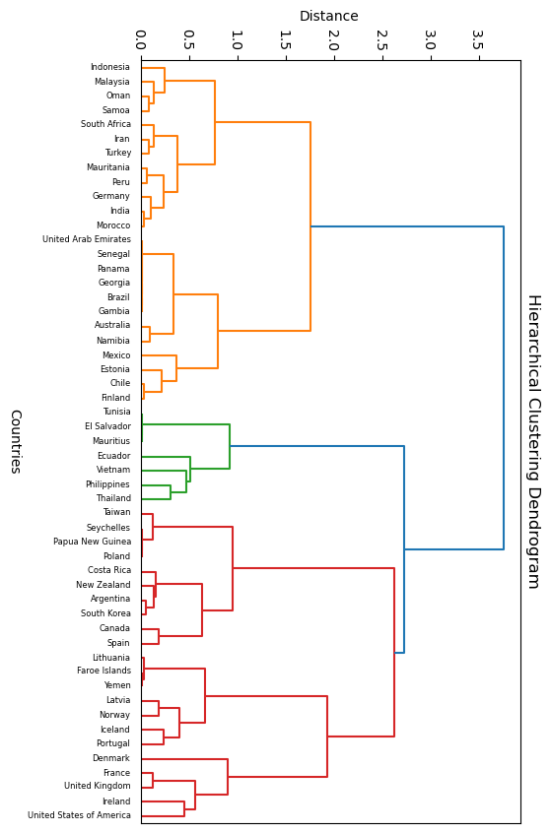
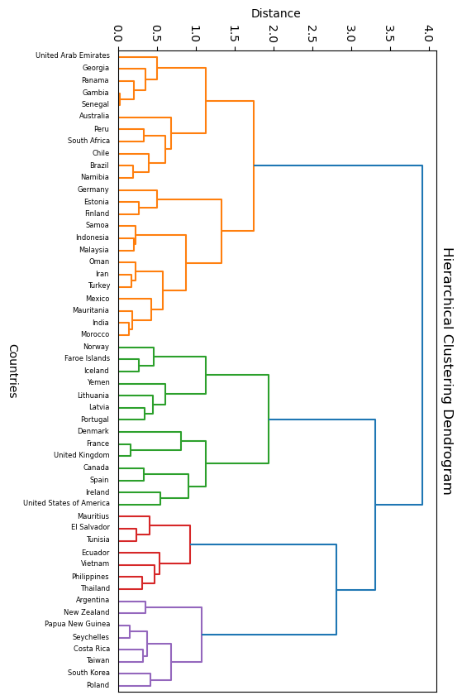
Profile
Profile + gdp
Profile + mean lat
Profile + gdp + mean lat

Slide 6
K=4
Profile + gdp + mean lat
K=5
Profile + gdp + mean lat

